Slide 1
Employee Data Analysis using Excel
STUDENT NAME:K JAYANTHAN
REGISTER NO:312201162
NAAN MUDHALVAN USERNAME:asunm110312201162
NAAN MUDHALAVAN ID:E58500BD3B7CD2F9FE9463B41F017231
DEPARTMENT:B.COM BANK MANAGEMENT
COLLEGE:DRBCCC HINDU COLLEGE

Slide 2
PROJECT TITLE
Employee Performance Analysis using Excel

Slide 3
AGENDA
Problem Statement
Project Overview
End Users
Our Solution and Proposition
Dataset Description
Modelling Approach
Results and Discussion
Conclusion

Slide 4

PROBLEM STATEMENT

Slide 5

PROJECT OVERVIEW

Slide 6
WHO ARE THE END USERS?

Slide 7

OUR SOLUTION AND ITS VALUE PROPOSITION

Slide 8
Dataset Description
Employee data- edunet dashboard
Total 26 features from a to Z
3 features were taken
Employee rating-number
Department - name
Employee id- text

Slide 9

THE "WOW" IN OUR SOLUTION
The 3D animated visualization result makes this a absolute blinder wow factor
3/21/2024 Annual Review

Slide 10
MODELLING
Data collection
Data cleaning
Filtering of data
Selecting the required fields
Converting them into a pivot table
Summarising the data
Getting the results from the data after arrangement
Getting the 3D graph
Doing the data visualization

Slide 11
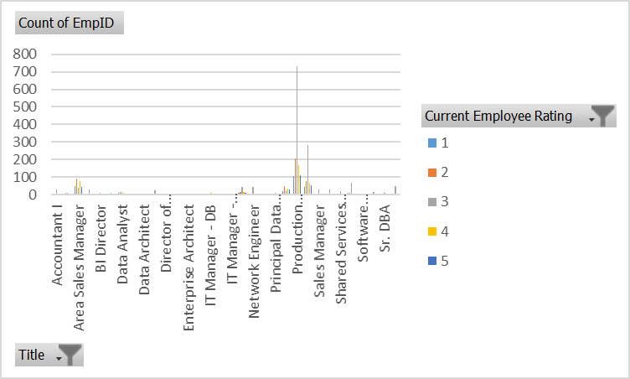
RESULTS

Slide 12
conclusion
By this data analysis we can be able to find the number of employees in the company based on their employee rating and the employee id so that the company will be able to find out the efficent workers for the company separately work and extract work from them. So that there will be an boost in the efficency of the company .

